Slide 1

Tata Steel Wires – Digital Strategy
19 / 12 / 2016
The information contained in the document is proprietary to Tata Industries Limited- Tata Insights & Quants Division and is strictly confidential. In consideration of receipt of this document, the recipient agrees that the information is being shared only for the limited purpose. The recipient of this information further agrees to maintain such information in confidence and to not reproduce, disclose, duplicate, electronically transmit or use in whole or in part for any other purpose. Prior written consent shall be obtained from the Insights & Quants Division of Tata Industries in case the information is necessitated to be shared with anyone other than the Recipient to whom this information is addressed. The above restriction shall not limit the right to use the information contained in this deck, if it is obtained from another source without restriction.
© Copyright, Tata Insights & Quants Division, Tata Industries Limited

Slide 2
The Digital Farmer : Today
Green Revolution
Ever-Green Revolution
Blue Revolution
White Revolution
Yellow Revolution
Biotech Revolution
ICT Revolution
Data Revolution
Empowerment of the farmer
Solutions that Empower Farmers :
Efficient supply chain systems through initiatives such as e-choupal
E-mandi initiatives which bring daily mandi prices online
Better Insurance & Crop Advisory solutions
Solutions that Enable Farmers :
E-governance for higher transparency such as land record digitization
Unique Identity through Aadhaar to ensure accurate access to govt. benefits
Increased penetration of ICT through mobile internet
Benefits from Precision Agriculture
Enablement through information
Expand market for better access
Solutions that help Expand the market:
E-commerce & E-tail for direct contact with end consumers in agro-based enterprises
Easier access to national & international markets : customers, technology & retail businesses
The Indian farmer story is that of a journey with many milestones signifying leaps in technology. We are now poised on the brink of the Agriculture Data Revolution that changes the farmers’ life in 3 key ways

Slide 3
The digital farmer journey
TOMORROW
Do It Yourself Tech
Irrigate via Smart Phone : Near Field Communication to turn on/off irrigation systems based on moisture sensor readings
GPS Mapping : Field indicator documentation for fertilizer applications
ICT Rev
Proposal for Kisan T Channel: Dedicated to the interests of the agriculture and allied sector has been proposed to launch in financial year 2014-15. This will provide real time information to famer regarding new farming techniques, water conservation, organic farming, etc.
Budget 2014-2015
TODAY
Information Thrust
National Policy for Farmers
Broadband Penetration, M-Services for crop advisories, National Optical Fiber network for better coverage, Mobile Value Added Services for Women SHG’s, Kisan Credit Card scheme, Kisan Choupal, Kisan Call Center, Kisan SMS Portal & Web Portal, Sandesh Pathak (Text to Speech for SMS advisory), Village knowledge & Resource Center
Information to farmers on seeds, fertilizers, pesticides, Govt. Schemes, Soil recommendations, crop management, weather and marketing of agriculture produce
E-Agriculture : Mission Mode Project
YESTERDAY
While the focus till now has been to tell the farmer what to do : the focus tomorrow will be the ability to respond when he tells us what he wants : To do that we need to develop the capability to Listen via trends in Data
Confidential Property of Tata Industries Ltd – Tata Insights & Quants Division

Slide 4

Why Data is the Next Big Thing in Indian Agriculture
Supply Chain Data for better distribution : Telematics on fleets carrying produce, Data from storage locations on crop health, Retail store data to track consumer demand can be integrated.
Food Inflation : By estimating patterns in demand & Supply by integrating data on sowing, harvest & production esp Satellite Imagery for yield
Status Quo : Forecasting based on time series data
Future : Forecasting based on real time dynamic factors : climate, macro-economic conditions
Food Inflation
Distribution System
Soil Fertility : Data from on-field devices, satellite imagery, smartphone photos, meteorological data etc.
Food Security : Real time assessment of crop throughput can enable gov. take proactive measures such as : farmer advisory for glut and import orders in case of dearth
Food Security
Soil Fertility & Productivity
Farm Produce Wastage
Crop Financing
Financiers will need to integrate data on the farmer to reduce risk & on farm produce from a number of sources : KYC, on-field device, weather, soil, pest condition etc.
Tackling Wastage in Storage & Transport : Through sensor data on moisture, temperature, pressure, infestation by rodents etc.
Drivers of Data Adoption : Smart Phone Penetration >> Increasing App Usage >> Vernacular Data Sharing
Rising Ag-Data Start-Ups : CropIn, Skymet, AgRisk
Global Indicators : Monsanto’s Integrated Digital Platform for farmers to analyse agronomic data
Verizon : Ag-Software based on IoT in Monterey & Napa Valley

Slide 5
Data and analytics requirement to drive growth in agri business
Data & Analytics can be leveraged across the Agri-Business value chain for High level Strategy & to Deep-Dive into Individual Consumer Preference
Aggregate Data on Markets
Industry Indicators
Real time Data on Weather Patterns, Soil etc.
Sensor Related Data Feeds from On-Field Devices
Product Usage from Transaction Data
Consumer Interactions : Online/Offline
Price Movements based on every day market prices | Crop Advisory for Sowing, Harvesting | Crop Quality Predictions & recognitions of indicators of pest attacks | Sales Forecasting for specific Produce & salesforce effectiveness models | NLP solutions on unstructured text data from customer feedback
Geo-level Demand Forecasting for Specific Produce | Weather & Soil predictions ahead of sowing | Predictions on estimated yield, Land Area Usage | Impact of Media & Advertising Spends if Any | Digital analytics based on engagement trends on Website or social media
Market potential for specific product based on market geo-profiles | Image processing solutions on satellite imagery to estimate total yield | Supply Chain effectiveness from fleet management solutions & farm machinery maintenance solutions | Channel Trends in dealer & distributor behaviour to predict attrition | Deriving product insights from NLP techniques on primary research such as FGD’s.

Slide 6

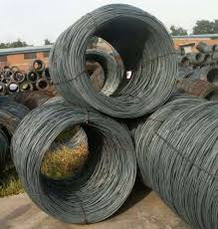
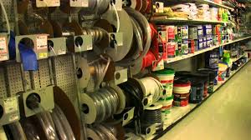
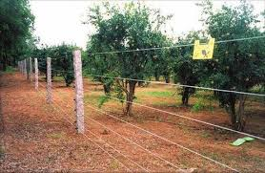
Drive one-to-one connect with the farmer
Leverage digital channels to establish one-to-one connect and leverage the power of analytics & recommendation to become the trusted advisor
Driving deeper engagement with retailers…..
…. and farmers
Tata Steel
Sales forecast
Weather and related crop data to aid sales
Product usage tips
Bundled solution selling – fencing solution
Digital channels to build the connect
Obtain more granular data
Implement analytical solution and build relationships
Distributer
List of prospects in the catchment
List of possible cross sell from existing customers
End customer empowerment
Knowledge dissipation
Inventory management
Cash flow management
Ongoing engagement – as the product is an infrequently purchased category
Retailer
Cross-sell and up-sell potential assessment
Marketing activity
Effective customer engagement
Farmer
Tata for farmers – integrated agri and rural consumption solution

Slide 7








Global best practice: John Deere
John Deere is already enacting its vision for a totally digitized future for Farming & is poised to reap first mover advantages
John Deere has released several products which connect its equipment with each other as well as with owners, operators, dealers & agricultural consultants.
This includes sensor data from its portfolio of farming equipment along with historical & real-time data from third party sources
Information is collated, analysed through tools such as R and exported to different channels for consumption such as :
  MyJohnDeere.com portal for fleet, weather, machine data and financial farming information
  FarmSight which monitors productivity, efficiency, farming logistics & gives decision support solutions
  iPad and iPhone app Mobile farm manager for soil samples & operations reports with remote access.
Farmland Data
Weather Data
Soil Statistics
Data & Analytics
Fleet & Fuel Data
Crop Stats
John Deere’s Vision for the future of Farming : https://youtu.be/jEh5-zZ9jUg

Slide 8
Start-ups and disrupters in India
Market Connect
Crop Decision Support
Digital India Initiatives
DARe
Jayalaxmi Agrotech
RML AgTech
m-Agriculture, m-GramBazar
DARe- Digital Agri. Rural
e-Marketing incubated by T-Hub :
cloud based application that will help connect large number of smallholder farmers with multiple buyers.
Helps in real-time price discovery using current e-mandi price, recent price trends, variety, and other quality parameters.
The application will also provide farmers location specific weather forecasts and information on technology providers in their locality.
Crop specific regional App provides comprehensive information to farmers & has been downloaded by 35K+ farmers.
Data on sowing, transplantation, fertilizers, dosage, pest management, reminders of irrigation schedule
Downloaded by 3.3 MM farmers, 10K traders & 30+ Institutional Clients RML provides following
RML Farmer : Crop Decision Support
RML Trader & REdge : Commodities Intelligence, tracks market prices etc.
As part of Digital India 3 key initiatives have been planned to give impetus to Agriculture sector :
mServices : focus on mobile phone services and penetration via increased band-width
mServices has 7 components of which the agri-relevant ones are :
  mAgriculture : market Extension
  mGramBazar : Marketing Services
mKrishi from TCS : Mobile Agro Advisory System
Market Place Platform
Krishidoot (GoI + RML)
Platform for directly selling produce to agri-businesses and for buying fertilizers and seeds via a government-backed technology platform, cutting out middlemen entrenched in wholesale markets.
Notes:
T-Hub incubted startup DARe- Digital Agri. Rural e-Marketing
Jayalaxmi Agrotech Private Limited
RML Information Services Pvt. Ltd. (RML)
Krishidoot
mKRISHI of TCS
Digital payment for agri section mServices, mAgriculture, mGramBazar

Slide 9





Exploring group synergies
Shared Insight into the Rural Consumer
Benefits of Shared Distribution Channels
Benefits from a Strong Affiliate Network
Benefits from Common Understanding of Risk Factors
Benefits from Cross Leveraged Base
Benefit from Cross leveraging a partner network
Benefits from Strategic Multi-Prong Marketing
Benefit from ability to reward Loyalty to Ecosystem
The time is ripe to Combine Tata Groups’ rural footprint across Group Companies to leverage multiple synergies

Slide 10
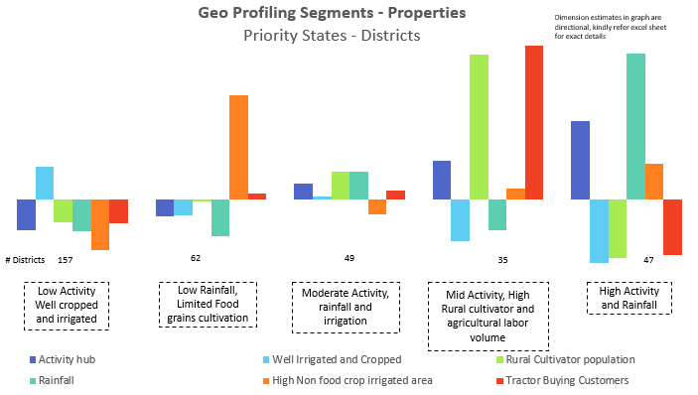
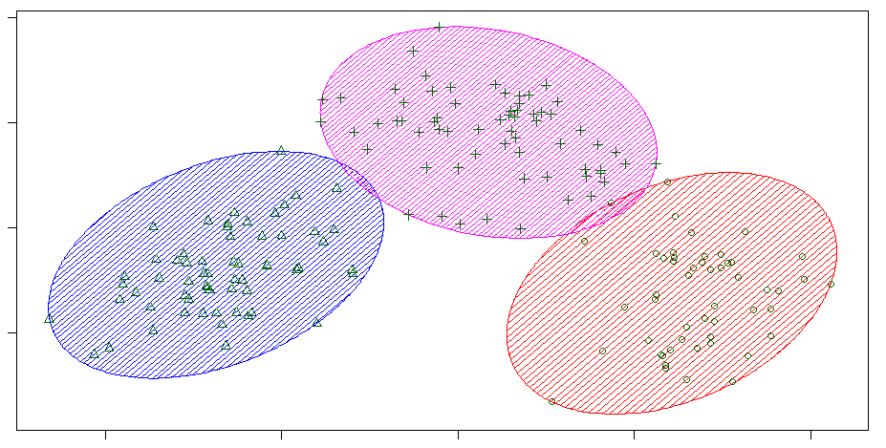

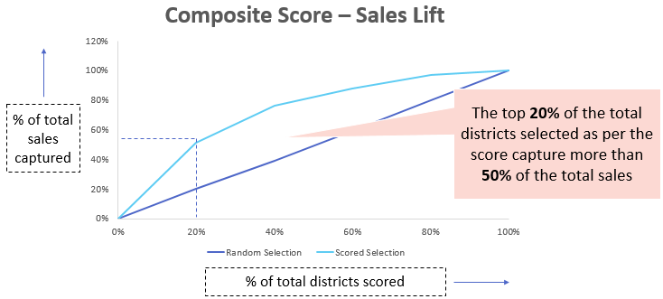

Territory Potential Assessment : Tata Steel Wires
Tata iQ is assessing territory potential across 7 priority states for Wiron
DATA MINING
METHODOLOGY
OUTCOME
Mine 200+ data points from public & proprietary sources for 7 Priority States & 360+ districts clustered into 9 vital metrics
Clustering on the list of vital metrics
Location Characteristic Metrics
Affluence & Activity Hub
Rainfall
Non Food Crop irrigated areas
Tractor buying Customers
Well Irrigated and Cropped
Rural, Cultivator population
Segments profiled based on the vital metrics to characterise & prioritize segments
Creation of a composite performance score to understand sales potential

Slide 11
About Tata iQ

Slide 12



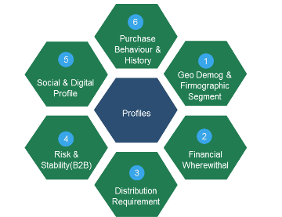

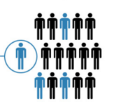











About Tata iQ
Our goal is to be India’s premier Omni-channel Marketing Solutions & Decision Sciences company powered by the richest and most valuable database, and high impact insights and analytics
Analytic Services
Largest and Richest Database
Collaboration and One Tata
Campaigns
Customer Insight &
Prospecting
Proprietary
Offline
Data
ShopsAPP
Risk Analytics
Public
Affiliate
Marketing
Online
Data
TSSS’15
Supply Chain
Operations
Group-wide Loyalty
Internal
Advanced Analytic Solutions
Tata iQ Proprietary Database
Building One Tata
Profiling, Segmentation, Predictive Analytics, Machine Learning
Quantitative Analytics, Existing Customer management (cross-sell, up-sell), Pricing, Channel, Store, Online, Assortment, Risk, Digital, Operations, Prospecting
900MM People Base
300 MM Enriched Base
Data across Individuals & Institutions
  Unified customer view, Maximize Revenue
  Minimize Expenses,
  Encompassing Loyalty mitigate risks, superior customer experience, sales/revenue growth
Confidential Property of Tata Industries Ltd – Tata Insights & Quants Division

Slide 13





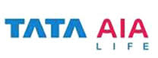



A wide ranging set of engagements across B2B & B2C
B2B
B2C
Advanced data management
Dedicated analytics hub
Digital analytics
Marketing analytics
Geo spatial analytics
Risk and operations analytics
Advanced machine learning & NLP
Advanced visualization

Slide 14
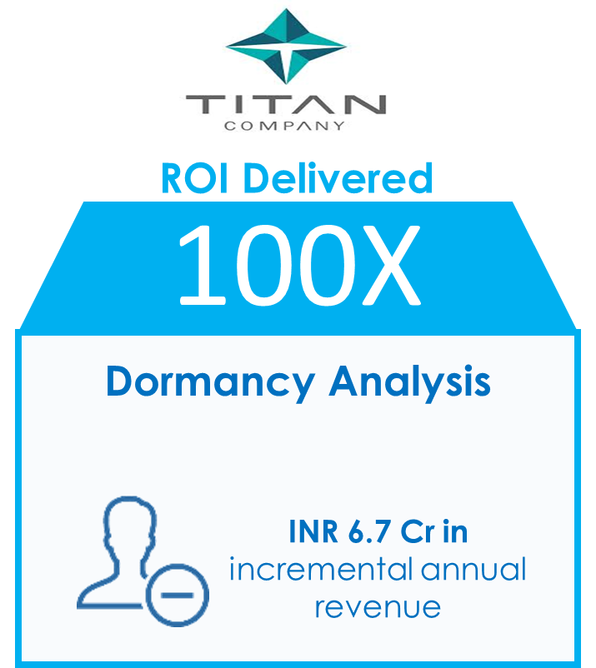
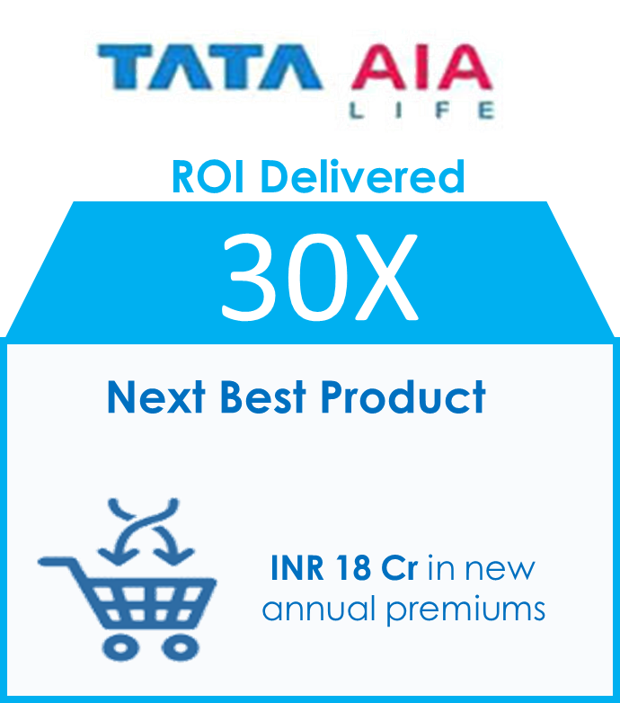
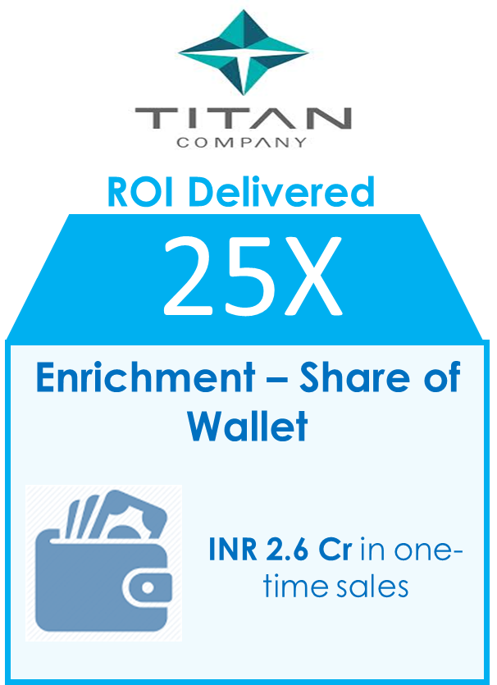
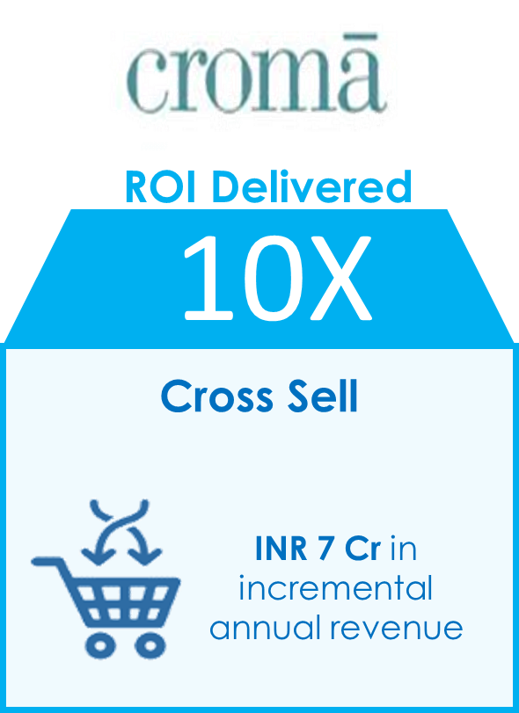
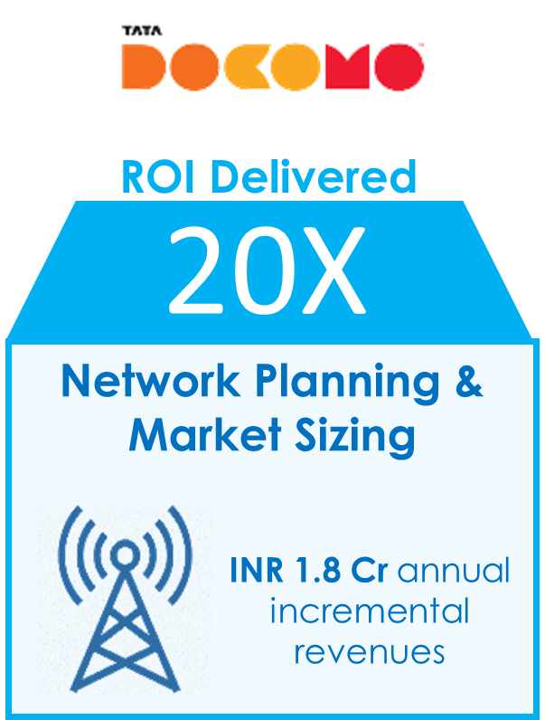
Business Impact Delivered
Investment is inclusive of the Cost borne by the Client and Investment in Infrastructure by Tata iQ

Slide 15

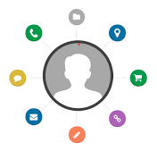

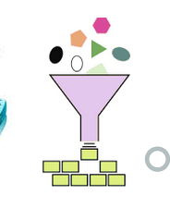
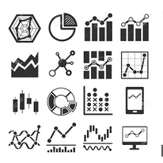
Leveraging the power of Big Data
Data Ingestion & Processing – Real time and batch
Single view of Customer
Organize data from 20+ sources
Frequency: Daily, weekly, monthly
Clients: Croma, Cliq, TCL, Tata AIA
360 view of customer across organization & products
Matching Algorithms
Clients: Croma, Cliq, TTSL
Variety of Data
Unstructured : IOT, Social Media , Survey ,Clickstream, Email
Structured : Customer, Transaction, Campaign, Product
Clients: Croma, Tata AIA, Cliq, TTSL
Quality & Enrichment
Internal DQ improvement, Data cleaning rules etc.
Enrichment with Neo
Clients: Croma, Cliq, Titan, Tata Capital
Self serve Visualization
Data Discovery & Exploration
Executive dashboards
Clients: Croma, Cliq, Tata Capital, Tata AIA

Slide 16

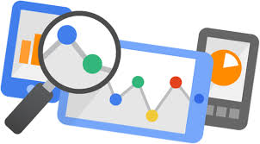
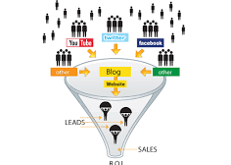

Leveraging the power of digital
Social Media
Web and App analytics
Social media tracking and social engagement analysis for Tata AIA – helped propel Tata AIA to the fastest growing in terms of engagement & reach
Social media for lead generation for Tata Capital – enhance accuracy from 11% to 72%
Social media for perception mapping for Tiago
Social media for positioning Tata Chemicals nutraceuticals
Browsing based segmentation & recommendation for Tata Cliq
Customer journey and funnel optimization – Tata AIA, Tata Capital, Tata Cliq
Evaluation of efficacy of various sources of digital leads – Tata AIA, Tata Capital, Tata Cliq
Competitive benchmarking – all Tata Group companies

Slide 17
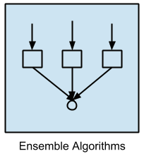
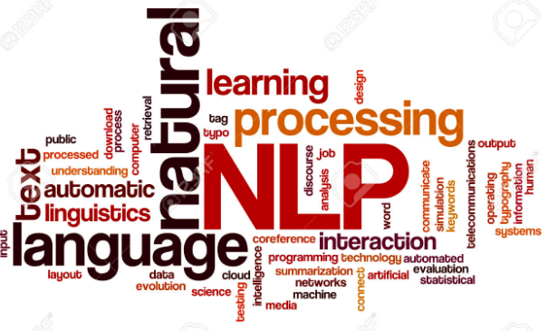
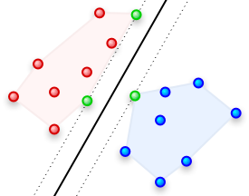
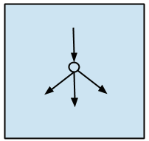
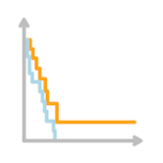
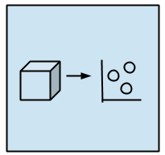
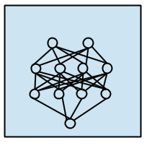
Leveraging the power of machine learning
Ensemble Algorithms
Natural Language Processing
Random Forest : Tata Capital
Stochastic Gradient Boosting : Tata AIA
Lead Tagging: Tata Capital
Text Mining : Tata Motors, Tata Steel, Rallis
Transliteration : Tata iQ Vernacular Database
Neural Networks
Support Vector Machines
Survival Analysis
Organization Collaboration : Tata Communications
LD-2 Process : Tata Steel
Matching & Classification : Tata iQ Proprietary Database
Survival Analysis for Titan
Dimension Reduction Algorithms
Deep Learning Algorithms & More..
Principle Component Analysis : Tata iQ Proprietary Database
Multi-Dimensional Scaling : Tata Motors
Boltzmann Machine
Differential Penalty for different types of errors

Slide 18









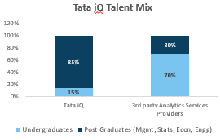






  Tata iQ is building a World Class Technology Solution
  with the Right Mix of Talent
TECHNOLOGY
TALENT
  NIMBLE
  Industry grade Hardware – Dell, Cisco,
  World Class data centre – Tata Communications
  Best of breed technology stack
Advisory Board
Hiring from
Premier Institutes
Pradeep K. Chintagunta
University of Chicago
Pulak Ghosh
IIM, Bangalore
  COST EFFICIENT
  Use of Big Data (Hadoop) Infra 1/5 Cost to traditional
  Mix of Open Source & industry grade tools.
  Best of breed tools
Gah-Yi Vahn
London Business School
Team Strength - 80
Global Businesses
Superior Talent Mix
  SCALABLE
  Big data Infra Scalable to 100x capacity
  Flexible infra model with Tata Communications.
  Time to scale < 3 months.
Confidential Property of Tata Industries Ltd – Tata Insights & Quants Division

Slide 19
Engagement with Tata Steel

Slide 20
Tata Steel and Tata iQ – the partnership model
Tata Steel Analytics COE – consisting of members of Tata Steel team and dedicated Tata iQ team
Other partners - tech
Customers - plant
KM
Repeatable Success
COE
Customers - marketing
Innovation
Tata Steel Seed Team
Tata iQ Seed Team
Tata iQ ad-hoc project team
Efficiency
Training
Customers – supply chain
Relationships
Technology
Customers – HR/Fin
Recruitment
Other partners – specialised services
Build the analytics COE, deliver quick impact projects, partner in creating POCs that are experimental in nature. And help manage peak loads when required.

Slide 21
POCs and Projects
Effective partnership model for initiating quick-win projects and POCs
Sales & Marketing
Factory & Operations Analytics
Other Areas
POC for TISCON
  Dealer and distributer dashboard
  Sales prediction
  Dealer attrition prediction
  Marketing effectiveness analysis
  Territory attractiveness
WIRON
  Territory attractiveness & potential assessment
  Sales forecasting
Flat products
  Text mining (using NLP and machine learning) for analysing DPCR reports
  Analysis of auto customer feedback
Projects initiated
  LD-2 steel chemistry and turn down temperature prediction using machine learning
  LD-2 breakout prediction
  Prediction of presence of sliver during slab casting
  Blast furnace tuyere failure prediction
Supported as knowledge partner
  Pellet plant quality prediction
Future projects
  Scrap optimization
  CRM PLTCM quality
Initial discussions with finance for admin spend management dashboard and prediction
Conversion of PLC data across various platforms to data for analysis
HR analytics priorities
Conducted knowledge sharing workshop on classification algorithms at Jamshedpur
Knowledge workshop for ~40 key executives at Bangalore in the area of analytics adoption in large-successful-legacy organizations

Slide 22
Other Engagements

Slide 23









Engagement Overview with Croma
Tata iQ replaced existing 3rd party analytic solution provider in April, 2016 and is currently engaged across the entire spectrum of its business that has already yielded significant business impacts.
Store Analytics
Pricing &
Promotions
Analytics
Merchandising Analytics
Customer Analytics
Campaigns
Analytics
Location Planning for Hyderabad
Store Launch
Price Optimization at an SKU and Category Level
INR 4 Cr in incremental annual revenue
Area Compromised Store Assortment Optimization
Purchase Propensity models recommended targets for campaigns
Model-based Campaigns to drive targeted response rates
INR 6.8 Cr in incremental revenue

Slide 24

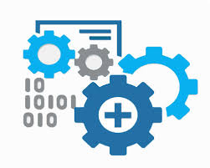



Engagement Overview with AIA
Tata iQ has a strong operating model with AIA that has yielded significant benefits across various business imperatives
Digital
Analytics
Increasing Product Depth
Customer
Acquisition
Reactivation & Lapsation Prevention
Next Best Product Framework (ML Techniques) based on customer life-stage segmentation
Text Analytics helps improve Brand Social Media Presence
Customer Acquisition Models (ML Techniques) to identify potential new customer
14
Reactivation of Dormant Customers to drive cross-sell
2
New Annual Premiums
12%
“Followers“ acquisition rate
New Annual Premiums
Crores
3
Crores
New Annual Premiums
(vs Competition 5 %)
20K
2.5X
Crores
Driven by email Marketing
Conversion Rate within 42 days
2.2X
Reactivation rate within 90 days
Leads

Slide 25








Engagement Overview with Unistore
Tata iQ currently has a dedicated 9 member team for Unistore supporting both foundational Reporting, marketing strategy consulting supported by data analytics, and conversion through digital channels
Visualization
Digital Analytics
Marketing Analytics
Customer
Enrichment and
Prospecting
Executive dashboard and operational reports using Tableau
Understanding the Conversion Funnel, Channel Effectiveness for better Acquisition
Customer Demographic and Behavioural Profiling and Engagement Framework to drive Engagement and Retention
Campaign management and Neo based Prospecting Campaigns to drive incremental sales

Slide 26



Engagement Overview with Tata Motors
Existing Service Provider
In house through Tata Technologies, Accenture
Business Objectives :
Leads prioritization for Tiago
Telematics Analytics
Analytics for AMC, Extended Warranty risk, pricing
TIME
LINES
Tiago Leads Prioritization & Perceptual Map - initiated
GDC Engagements-initiated
Vehicle Prognostics-initiated
Dealer Location Optimization -initiated
APR’16
JUN’16
JUL’16
AUG’16
OCT’16
Analytics – Marketing Analytics
Analytics – Telematics
Neo Based – Location Attractiveness
Business Unit : Passenger Vehicle
POC : Tiago Leads Prioritization (ML & Regression)
Status : Completed
Outbound calls to 30k prioritized leads across 23 cities
3.3X Increase in Conversion rates over 90 days
POC : Tiago Perceptual Maps
Status : Completed
NLP Techniques used for sentiment analysis of social media posts
Revealed Tiago’s perceptual similarity to RENAULT Kwid
POC: Vehicle Prognostics - based on telematics data from CVs
Business Unit : Commercial Vehicles
Status : In-Progress
Project : Dealer Location Optimization
Business Unit : PV and CV
Status : In-Progress
Opportunities:
Procurement, dealer network optimization, location planning
Hexa Launch – Targeted Marketing
Analytics – Pricing & Procurement
Project: AMC Pricing and Procurement Analytics
Business Unit : Commercial Vehicles
Status : In-Progress
Challenges :
Legal discussions decentralized in nature leading to Tata iQ having to engage in lengthy discussions with each department

Slide 27
Tata iQ Data – a key enabler

Slide 28




Project Neo Database – the power of Tata iQ data
35MM Individuals
Pan-India | 29 States | 640 Districts | 1600 Cities & Towns | 19000 Pin-codes | Street Level
100K Institutions*
Aggregate Indicators : Neo
AT PAR with Market Offerings
Database from other Brokers
Aggregate : Neo in Build Phase
Individual Indicators : Neo
SUPERIOR to Market Offerings
Very Limited Size of Individual Database for Targeting
Pan-India | 29 States | 640 Districts | 1600 Cities & Towns | << 19000 Pin-codes | Street Level
*Neo database on Commercial businesses kicked off in July, 2016
Notes:
Chitra to check this slide.

Slide 29









Clusters
& Networks
Tata iQ is Creating the Richest and Most Valuable Database
Access to Strategic Sources
Superior Data & Analytics Capabilities
Tata iQ Attributes
Identifier Information
Tata iQ Proprietary Database
Advanced
Algorithms
Data
Mining
Proprietary
Logic
Purchase Behaviour
Data
Engineering
Internal Tata Co. Data
Location & Demographics
Public Database
Data
Insights
Data
Intelligence
Digital Persona
Big Data Management Expertise
Analytics to mine Customer Insights
Permissible access to leverage Group Co. Data
Big Data Capabilities to handle large data volumes
Associations, Clubs and Passions
Individuals, Households and Lineages
Tata Company Relationships
ON THE
BEDROCK OF
ISO 27001
Certification
Non-disclosure
Security
Purpose
& Consent
Confidential Property of Tata Industries Ltd – Tata Insights & Quants Division

Slide 30


..To Respond to Business Needs
Building a Complete Customer Picture for Every Indian
Business Results
Behaviour
Financial
Wherewithal
Household
Profile
Geo-Demographic
DISCOVER
Existing Untapped Potential
Low
Ultra High
High
10%
Low
20%
Revenue/customer
Cross Sell & Up-sell
Churn &
Dormancy
70%
Untapped
Potential
Attitudes
*Illustrative
Relationship with the Tata brand
Loyalty
Risk Profile
Company
Value of Customers
Actual Value of
Customers
New Avenues for Growth
Universe of People
Past Purchase
History
Higher Conversions
Customer Base Growth
Cost of Customer Acquisition
Ethnic Profile
Discretionary Wallet
Digital Footprint
Identified Prospect
Confidential Property of Tata Industries Ltd – Tata Insights & Quants Division

Slide 31




Summary of Analytics Engagements
Active engagements with 18 Group companies across a diverse set of initiatives ranging from Customer, Operations, Pricing, Risk management, Digital, and Geo location based decision management.
As on Dec 11th, 2016
Sector | CLIENT | PoC | Turnkey/Full Partnership | ENGAGEMENT OVERVIEW
Financial Services |  |  |  | Digital, Reactivation/Lapsation, Prospecting, Salesforce management
 |  |  |  | Renewal / Lapsation Strategies, Cross Sell, Contactability Enhancement, Fraud & Digital
 |  |  |  | BL Opportunity framework, Digital analytics, Fund raising on Neo base, Prospecting
Retail |  |  |  | Customer, Store & Merchandizing, Campaign Management,, Data Management, Visualization
 |  |  |  | Segmentation, Next Best Product, Prospecting, Digital, Data Management, Recommender Engine
 |  |  |  | Migration & Dormancy, Customer Enrichment
 |  |  |  | Enrichment, Store Potential & Attractiveness, Customer Potential assessment
 |  |  |  | Store Attractiveness (Bandra), Customer Segmentation, Market & media mix, Drive Store Footfall
 |  |  |  | Organization-wide Category dashboard, Margin analysis, Promotions Planning
Hospitality |  |  |  | Segmentation & Propensity Models
Manufacturing |  |  |  | Territory attractiveness, Net Promoter Score Analysis, Factory Analytics, Analytics COE
 |  |  |  | Customer Analytics, Location planning, Demand forecasting, Survey, Prospecting, Social Analytics
 |  |  |  | FGD analysis, Territory attractiveness, Data Management & Visualizations
Utilities |  |  |  | Location Planning, Wi-fi Planning, Data Enrichment, Churn Models, Data Management (SME Business)
 |  |  |  | Call center analytics
 |  |  |  | Prospecting in rural markets, Cross Sell,
 |  |  |  | Pricing & Churn Analytics
Automotive |  |  |  | Lead Prioritization, Dealer Location planning, HR Analytics, AMC Pricing, Procurement, Telematics
PoC Stage
Turnkey / full Partnership
PoC yet to start

